Slide 1


+
Vue
Vite

Slide 2
TABLE OF CONTENT
What is Vite?
Why should you use Vite?
Example project

Slide 3
What is Vite?
Vite is framework-agnostic and works with multiple frameworks.
Vite is known as a rapid development tool for modern web projects. It focuses on speed and performance by improving the development experience.
For instance, it offers official templates for React, Vue, Preact, Svelte, Lit and even vanilla JavaScript and TypeScript. It offers multi-page support. Vite offers a “library mode” that can be used for creating browser-oriented libraries.
https://www.telerik.com/blogs/whats-vite-guide-modern-super-fast-project-tooling

Slide 4
Why should you use Vite?
Vite is really fast, because it leverages native ES modules and doesn't need to rebuild the whole bundle when something changes. This makes it fast, regardless of the size of your application.
Vite isn't specific to Vue, but instead is a way to develop JavaScript/TypeScript applications.
https://vitejs.dev/guide/why.html
https://www.codemag.com/Article/2109071/Introducing-Vite-A-Better-Vue-CLI

Slide 5
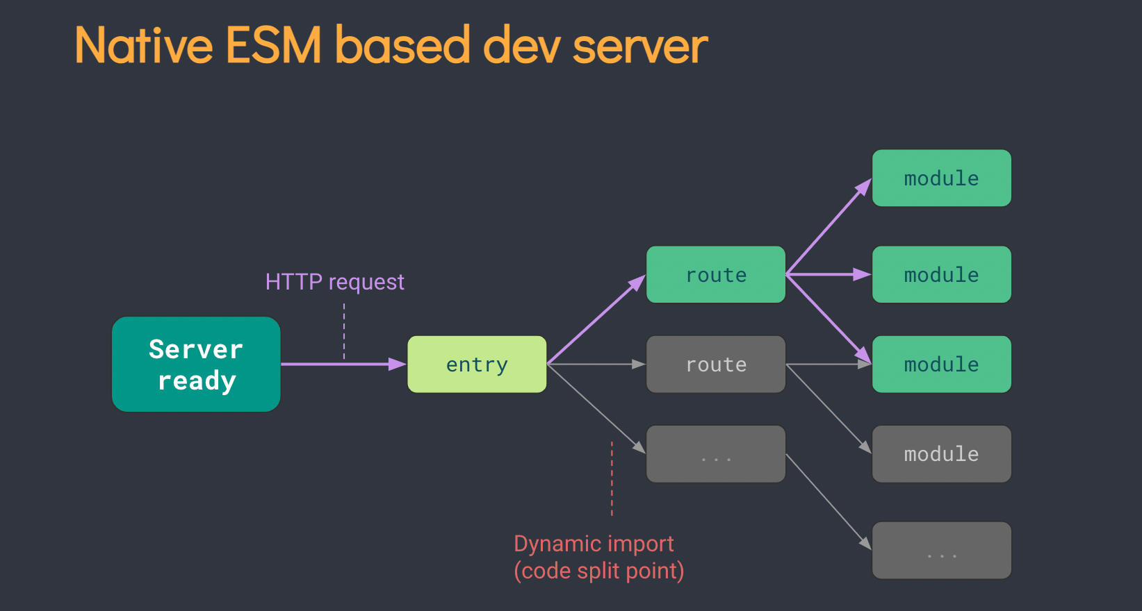
Why we should use Vite
What makes Vite fast (ES Module)
https://www.telerik.com/blogs/whats-vite-guide-modern-super-fast-project-tooling

Slide 6
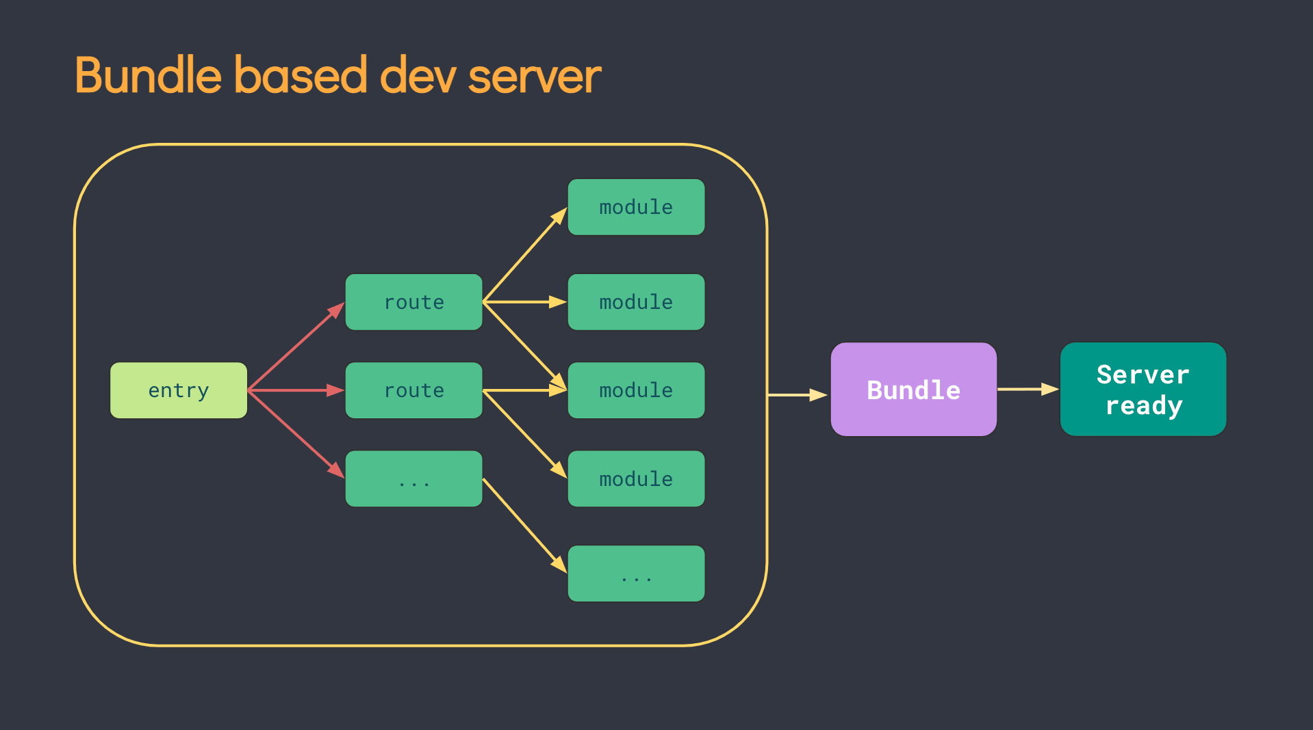
Why we should use Vite
Webpack (Slow bundle)
https://www.telerik.com/blogs/whats-vite-guide-modern-super-fast-project-tooling

Slide 7
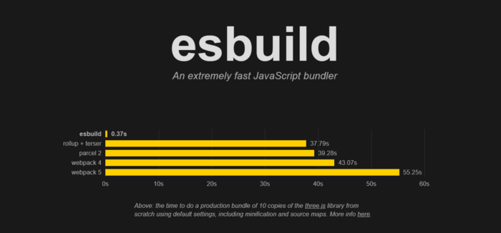
Why we should use Vite
Bundles comparation
https://www.telerik.com/blogs/whats-vite-guide-modern-super-fast-project-tooling

Slide 8
Example project with Vue + Vite

Slide 9
Thank you!

